Slide 1

6th Grade Accelerated Math
Unit 12, Lesson 1 Creating Proportions Volume 2, pg. 213

Slide 2


Benchmark
MA.7.AR.3.2
Apply previous understanding of ratios to solve real-world problems involving proportions.
volume 2, pg. 213

Slide 3
Integrated Mathematical Thinking and Reasoning Standards
MA.K12.MTR.2.1 Demonstrate understanding by representing problems in multiple ways.
volume 2, pg. 213

Slide 4

Learning Target
I can create proportions to represent a situation.
volume 2, pg. 213

Slide 5

Warm-Up
volume 2, pg. 213

Slide 6
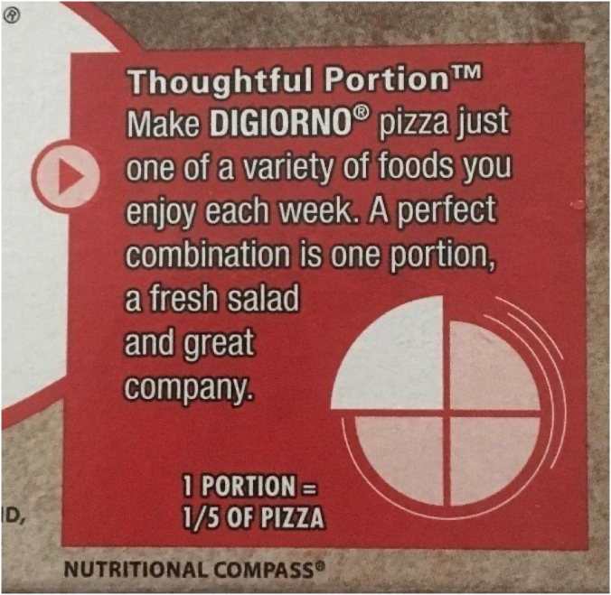
12.1.1 Warm-Up: Math Flop
The advertisement encourages making DiGiorno pizza a part of your weekly meals.
What do you notice about the advertisement?
volume 2, pg. 213

Slide 7

Exploration
volume 2, pg. 214

Slide 8

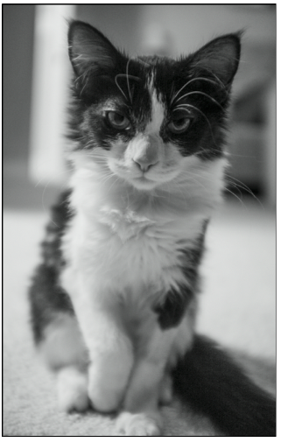
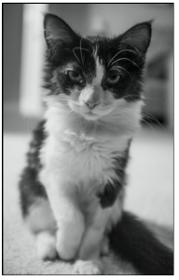
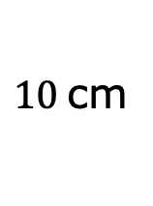
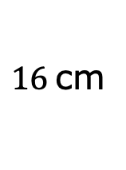
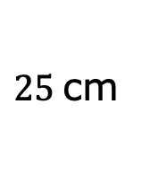

12.1.2 Exploration: Proportional Thinking
A photograph is enlarged to make a poster. Measurements are given in centimeters (cm).
$16$cm
$$?$$
$10$cm
$25$cm
volume 2, pg. 214

Slide 9
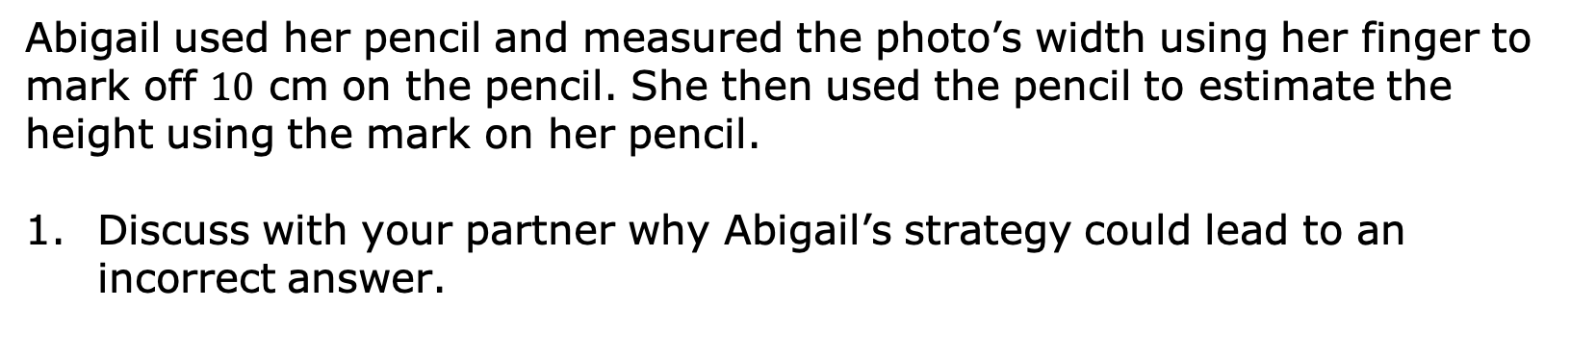
Abigail used her pencil and measured the photo’s width using her finger to mark off $10$ cm on the pencil. She then used the pencil to estimate the height using the mark on her pencil.
Discuss with your partner why Abigail’s strategy could lead to an incorrect answer.
volume 2, pg. 214

Slide 10
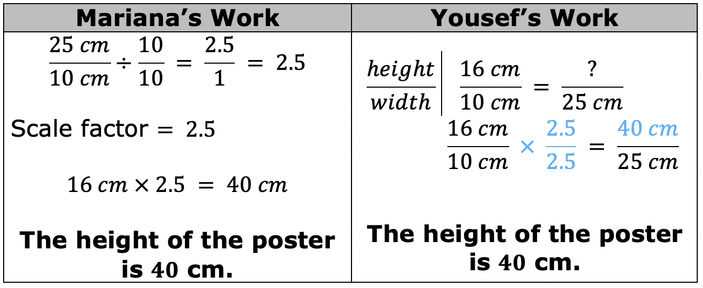
Mariana and Yousef used different strategies to find the height of the poster. Review their solution strategies. Then, work with your partner to answer the questions that follow.
How are Mariana and Yousef’s solution strategies similar?
How are their solution strategies different?
volume 2, pg. 214

Slide 11

Bring It Together
volume 2, pg. 215

Slide 12



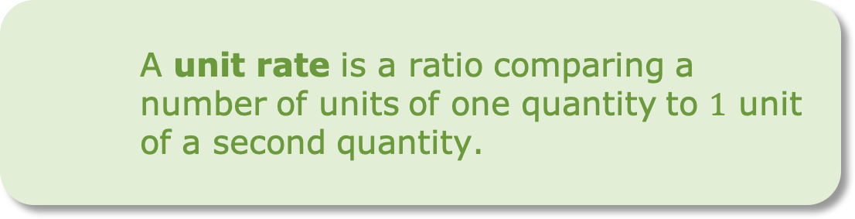
12.1.3 Bring It Together: Proportional Relationships
In a proportional relationship, the values for one quantity are each multiplied by the same number to get the values for the other quantity.
A proportion sets two or more equivalent ratios in such relationships as equal to each other and can be used to solve problems.
A unit rate is a ratio comparing a number of units of one quantity to $1$ unit of a second quantity.
volume 2, pg. 215

Slide 13
Use the words and phrases in the bank below to complete the description of Mariana and Yousef’s work.
The photograph and the poster are in a proportional relationship because the poster is a scaled version of the photograph. Mariana found the scale factor, which is a _______________, and multiplied it by the height of the photo to find the height of the poster. Yousef set up a _______________ stating the _______________ of the height to width of the photograph _______________ the ratio of the height to width of the poster.
volume 2, pg. 215

Slide 14

Guided Instruction
volume 2, pg. 215

Slide 15
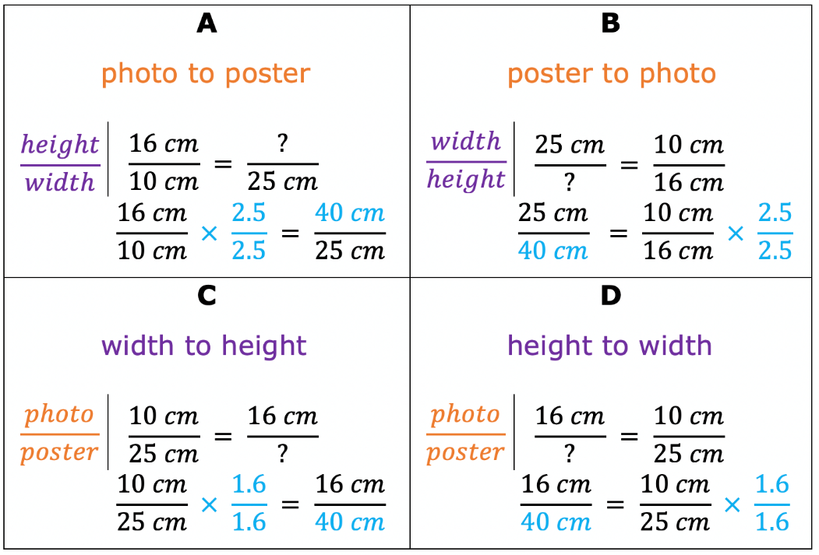
12.1.4 Guided Instruction: Proportional Thinking
Proportions can be set up in different ways using the relationships between each quantity.
Four different proportions that can be used to find the height of the poster are shown.
volume 2, pg. 215

Slide 16
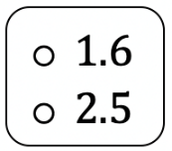
All of the proportions show that the ratios of the dimensions of the photograph and the dimensions of the poster are equivalent.
Complete the statements based on the proportions.
The dimensions of the poster are times larger
than the photograph.
The height of both the photograph and poster is
times larger than the width.
volume 2, pg. 215

Slide 17

Guided Practice
volume 2, pg. 216

Slide 18

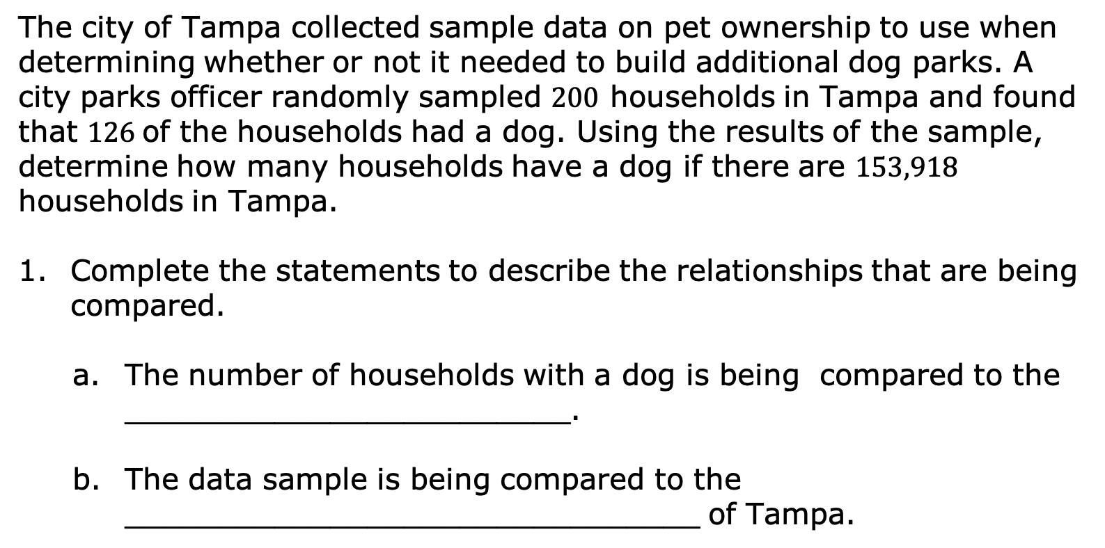
12.1.5 Guided Practice: Proportional Thinking
The city of Tampa collected sample data on pet ownership to use when determining whether or not it needed to build additional dog parks. A city parks officer randomly sampled $200$ households in Tampa and found that $126$of the households had a dog. Using the results of the sample, determine how many households have a dog if there are $153,918$ households in Tampa.
Complete the statements to describe the relationships that are being compared.
The number of households with a dog is being compared to the ________________________.
The data sample is being compared to the _______________________________ of Tampa.
volume 2, pg. 216

Slide 19

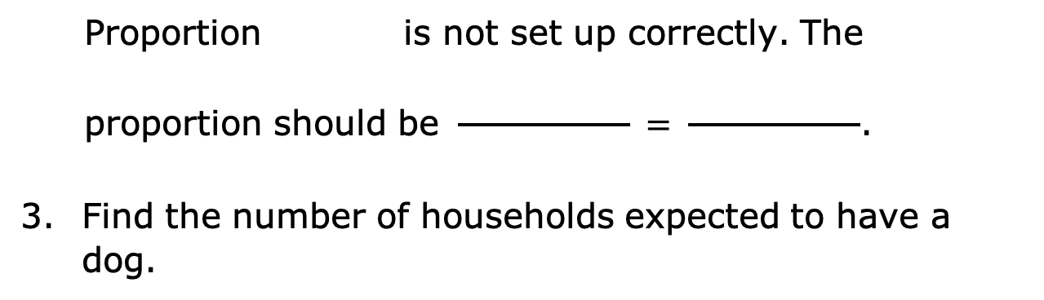
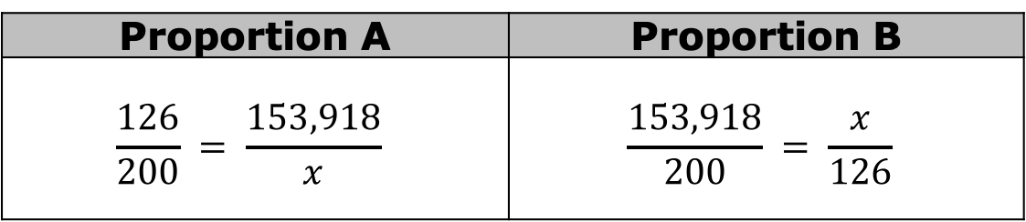
Two proportions that represent this situation are below, but one of them has an error.
Proportion A | Proportion B
$$\frac{126}{200} = \frac{153,918}{x}$$ | $$\frac{153,918}{200} = \frac{x}{126}$$
Proportion is not set up correctly. The
proportion should be $\frac{ }{ } = \frac{ }{ }$.
Find the number of households expected to have a dog.
volume 2, pg. 216

Slide 20

Collaboration
volume 2, pg. 216

Slide 21

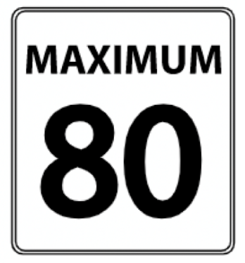
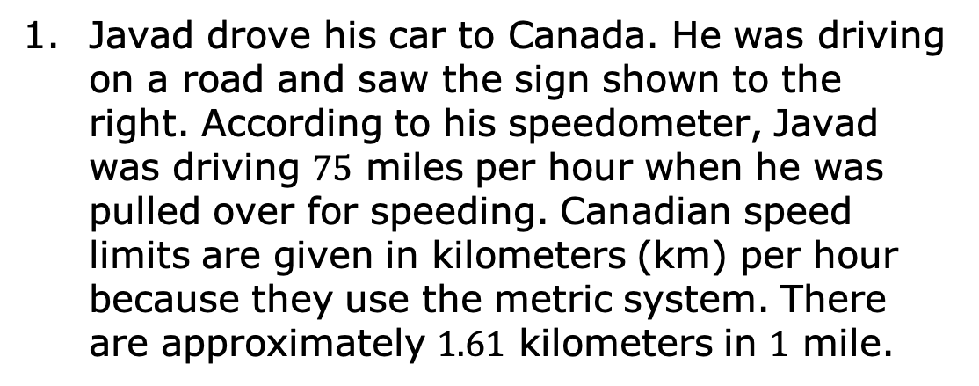
12.1.6 Collaboration: Creating Proportions
Javad drove his car to Canada. He was driving on a road and saw the sign shown to the right. According to his speedometer, Javad was driving $75$ miles per hour when he was pulled over for speeding. Canadian speed limits are given in kilometers (km) per hour because they use the metric system. There are approximately $1.61$ kilometers in $1$ mile.
Create two different proportions that could be used to find Javad’s speed in kilometers per hour.
Proportion A | Proportion B
volume 2, pg. 216

Slide 22
How fast was Javad traveling in kilometers per hour?
volume 2, pg. 216

Slide 23
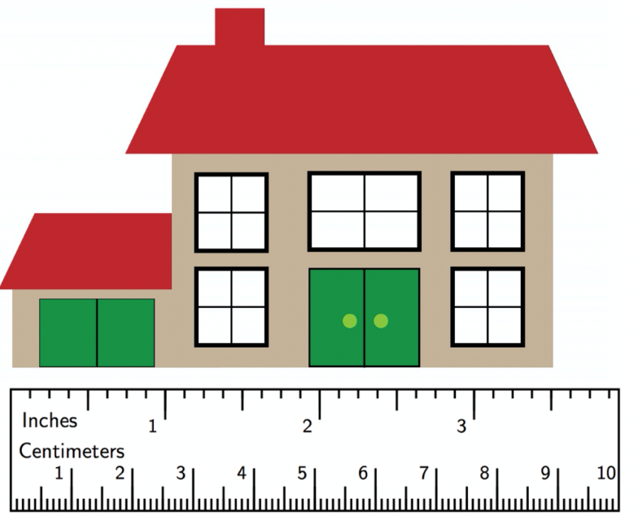
An architect made a scale drawing of a house as shown.
The scale for the drawing is $\frac{1}{4}$ inch $= 6$ feet.
volume 2, pg. 217

Slide 24
Create two different proportions that could be used to find the actual length of the house represented by the drawing.
What is the length of the house represented by the drawing?
Proportion A | Proportion B
volume 2, pg. 217

Slide 25

Wrap-Up
volume 2, pg. 217

Slide 26
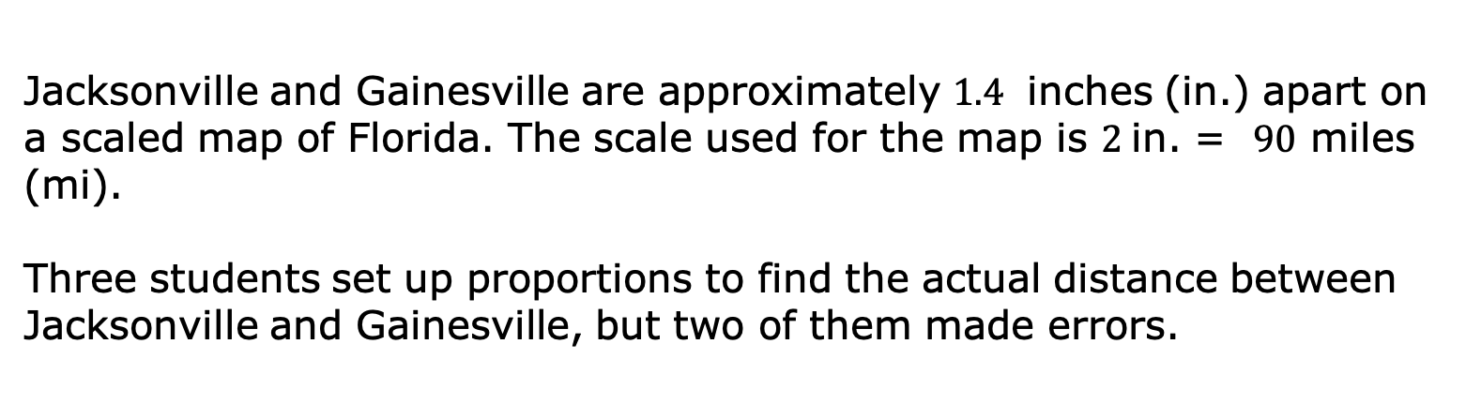
12.1.7 Wrap-Up: Error Analysis
Jacksonville and Gainesville are approximately $1.4$ inches (in.) apart on a scaled map of Florida. The scale used for the map is $2$in. = $90$ miles (mi).
Three students set up proportions to find the actual distance between Jacksonville and Gainesville, but two of them made errors.
volume 2, pg. 217

Slide 27
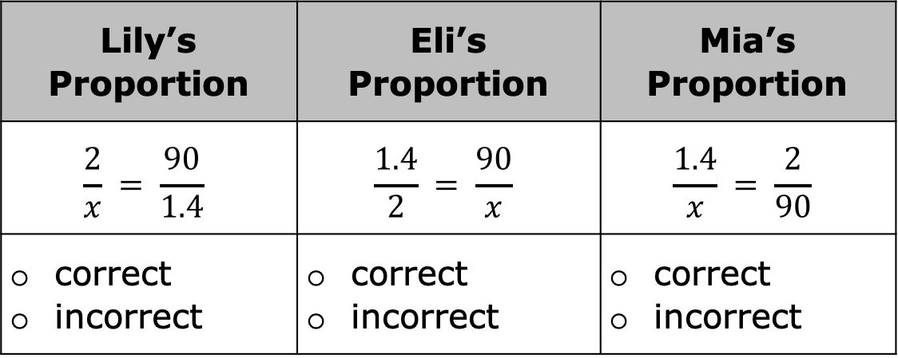
For each proportion, check whether it is correct or incorrect. If it is incorrect, fix the error by changing one of the ratios in the proportion.
Lily’s Proportion | Eli’s Proportion | Mia’s Proportion
$$\frac{2}{x} = \frac{90}{1.4}$$ | $$\frac{1.4}{2} = \frac{90}{x}$$ | $$\frac{1.4}{x} = \frac{2}{90}$$
correct incorrect | correct incorrect | correct incorrect
volume 2, pg. 217

